Slide 1
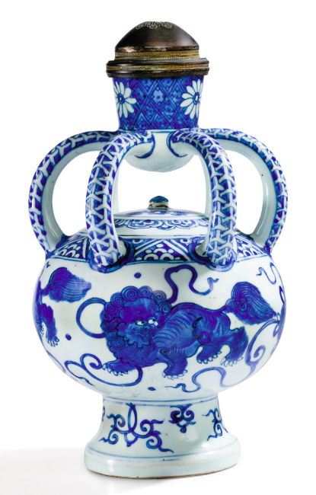
Is there a Patriotism Premium in Ancient Chinese Art Auction
Kebing Li

Slide 2
Motivation
Interest in the external determinants of selling price in art auction
Reports show price inflation in Chinese artwork
Chinese market has taken off since 2000
An event happened during YSL auction

Slide 3
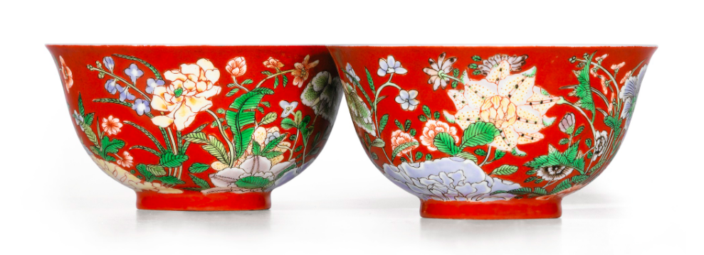
Literature Review
Relate to the idea of Charity Premium (Elfenbein & McManus, 2010)
Introduce historic contexts of Chinese lost treasures (Richard Kraus, 2009)
Trade-war US-China may affect art market (NY Times)
Chinese art market has a negative beta, a good investment option (Lodger, 2010)

Slide 4
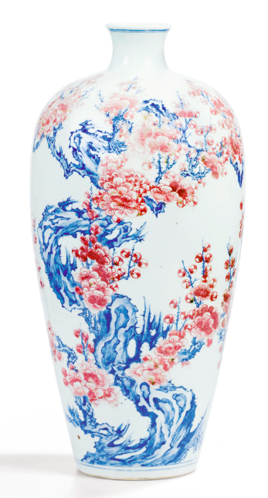
Methodology
Determine the premium: High Estimate Premium; Low Estimate Premium; Mid Estimate Premium
Premium = (Selling Price - Estimate)/Estimate
2) Macro indicators for Political factors (ideas)
Exchange rates (monthly data)
FDI (yearly data)
Economic Policy Uncertainty (monthly index)

Slide 5
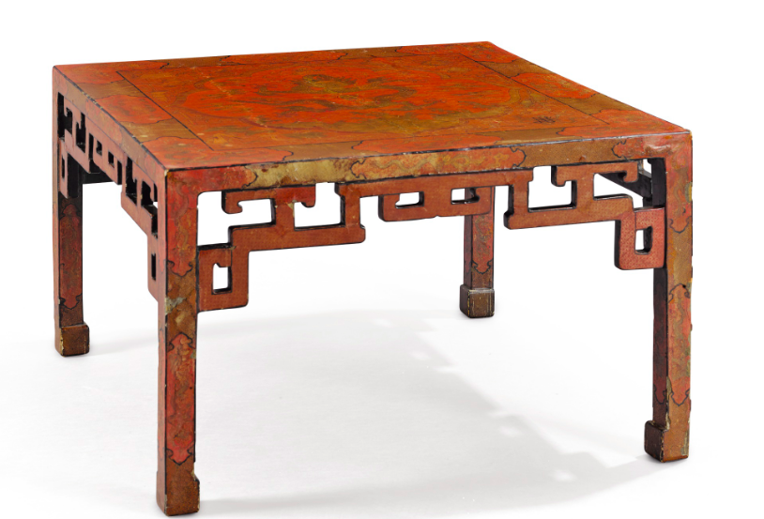
Data
For the premium, the paper “Are Art auctions estimates biased” (Ekelund, Jackson, Tollison, 2013) shows an on average 10%-45% underestimate of the selling price for American art.

Slide 6
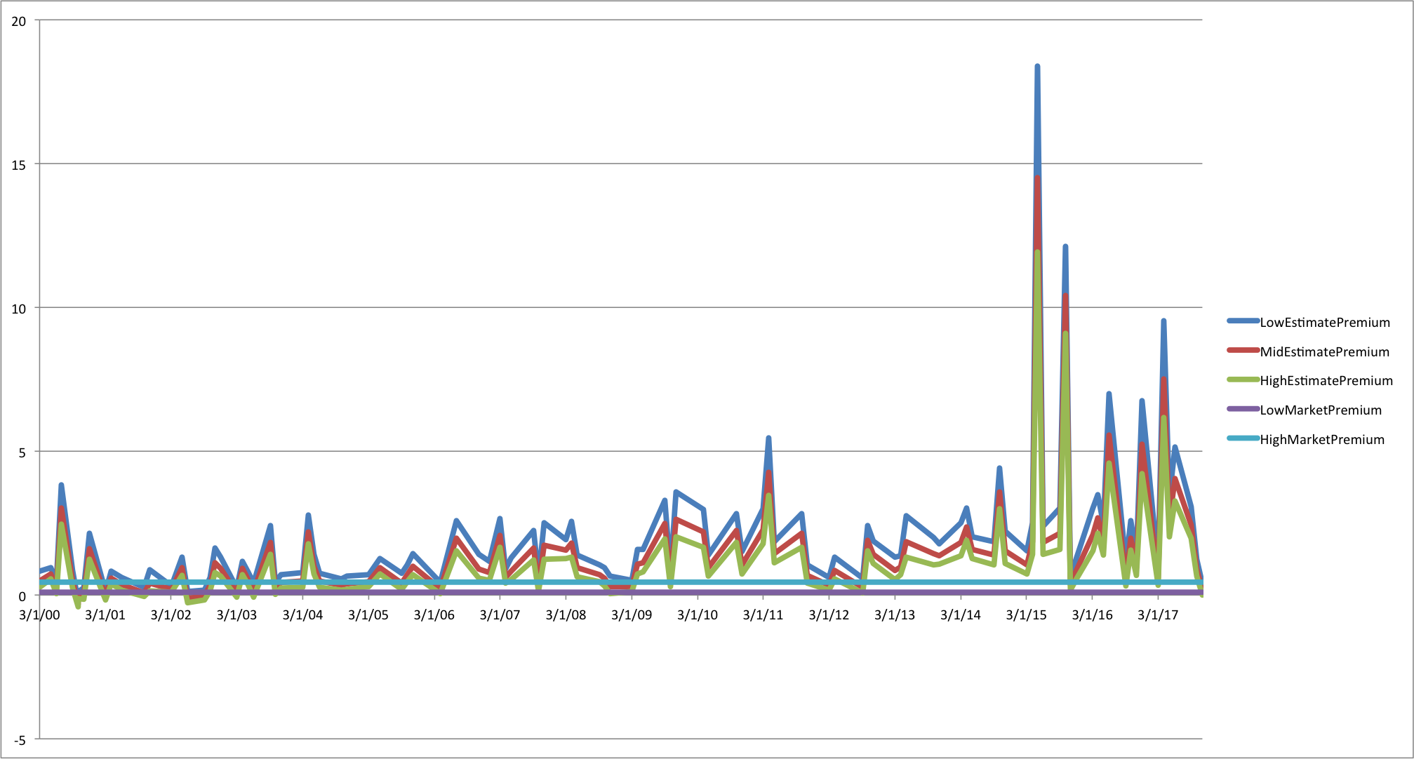

Slide 7
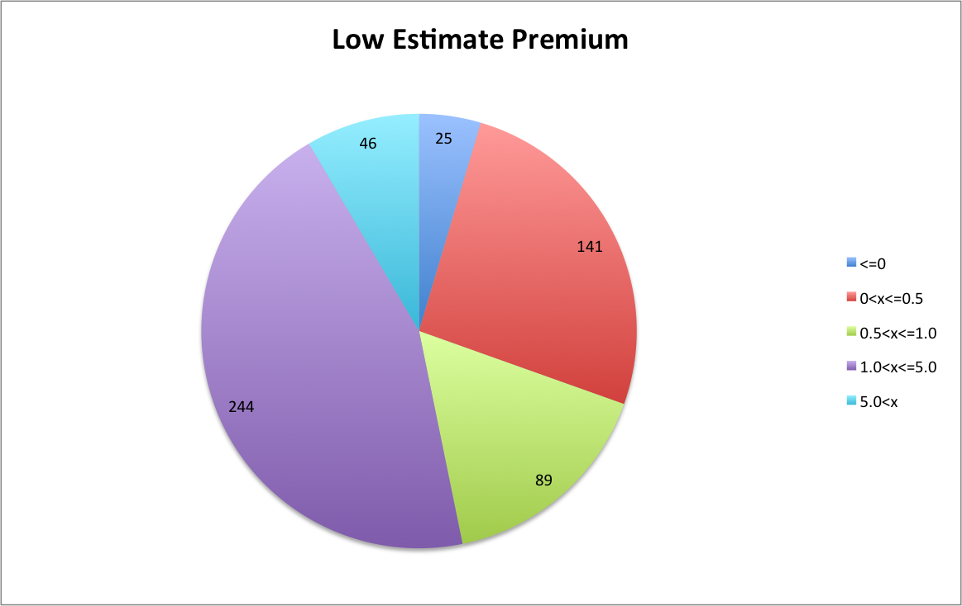

Slide 8
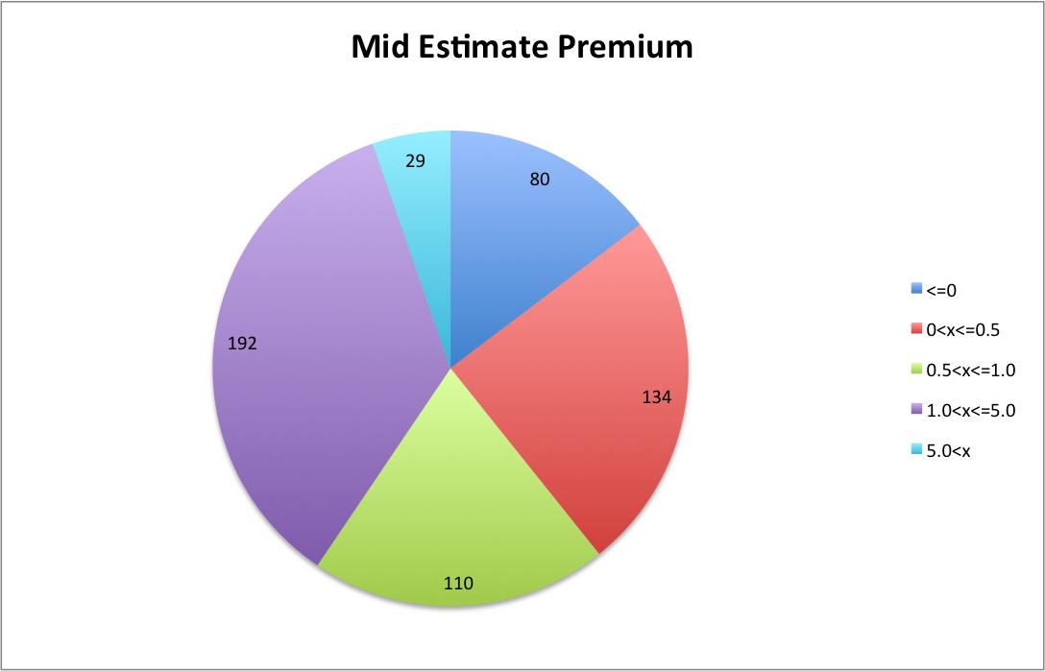

Slide 9
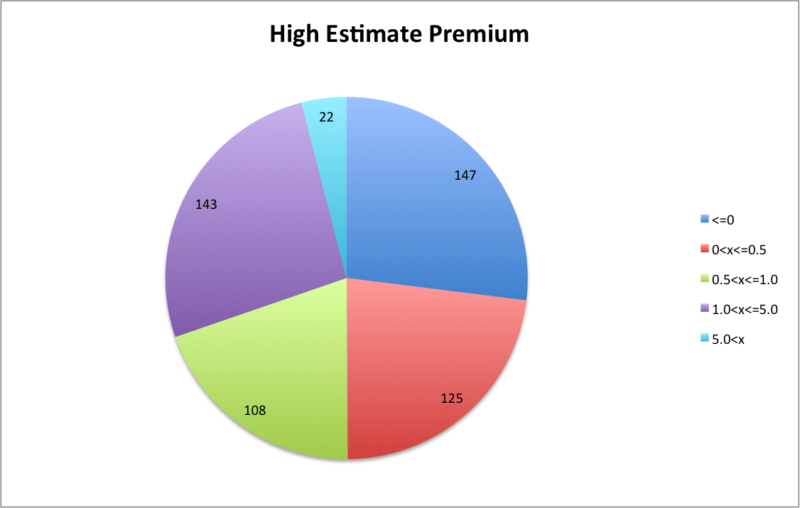

Slide 10
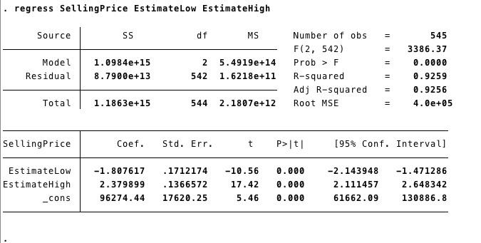
Empirical Analysis: before considering premium
See which estimate is the best:

Slide 11
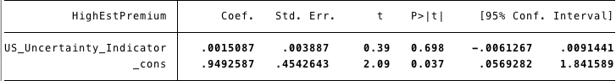
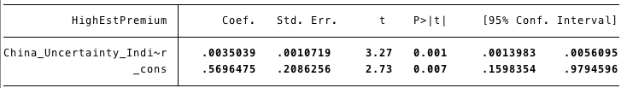
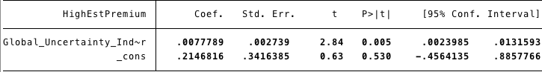
Empirical Analysis: Which indicators to be used

Slide 12
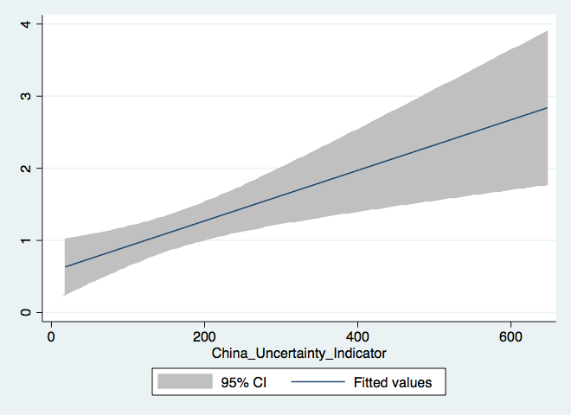

Slide 13
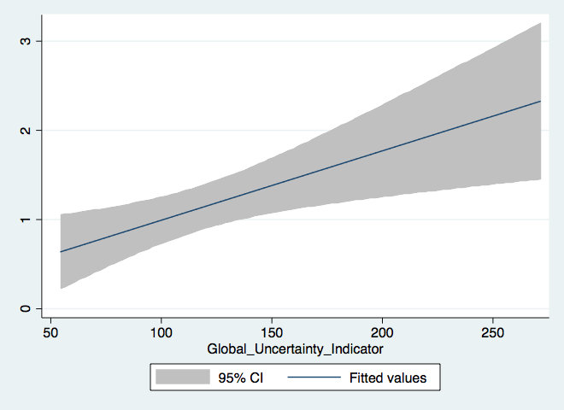

Slide 14
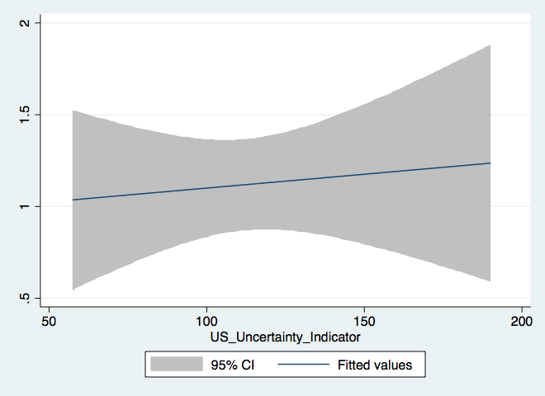

Slide 15
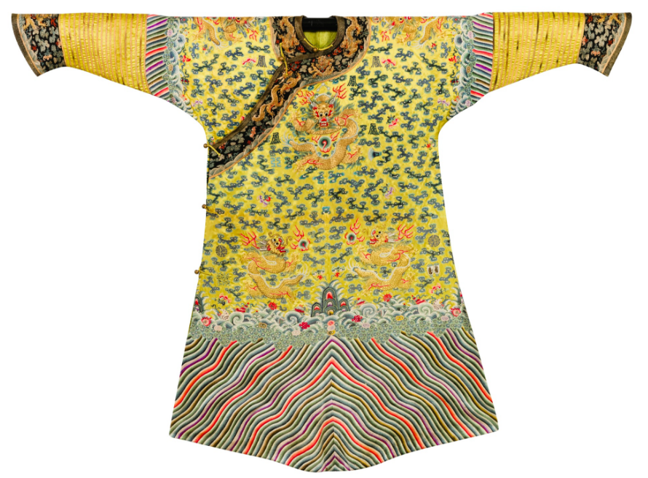
Empirical Analysis: Within-Medium Comparison
Paintings
Potteries and Ceramics
Jades and Jewelries

Slide 16

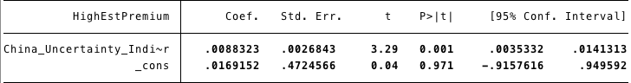
Paintings

Slide 17
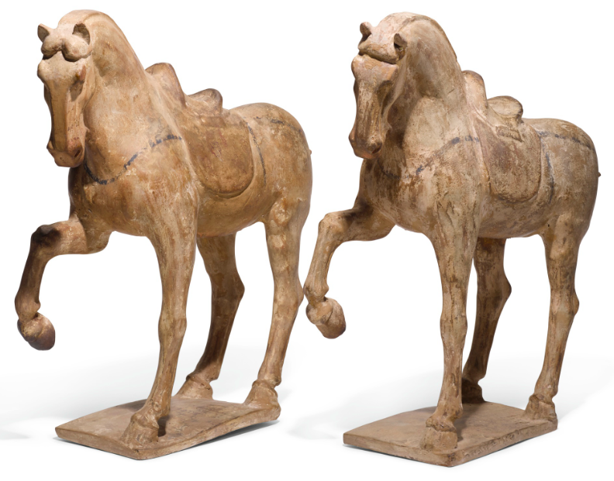
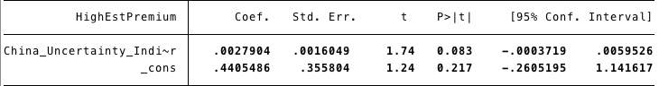
Potteries and Ceramics

Slide 18
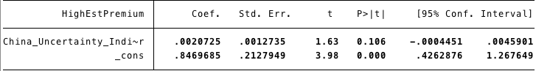
Jades and Jewelries

Slide 19
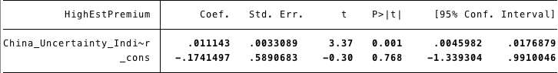
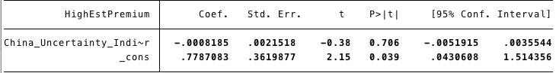
Empirical Analysis: Location (Asia vs. Outside Asia)

Slide 20
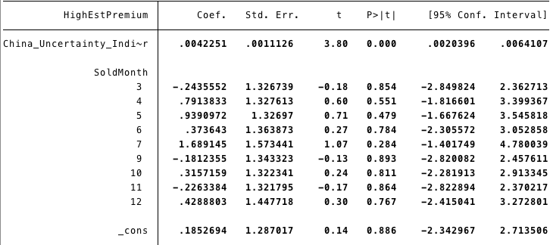
Empirical Analysis: Month effect

Slide 21
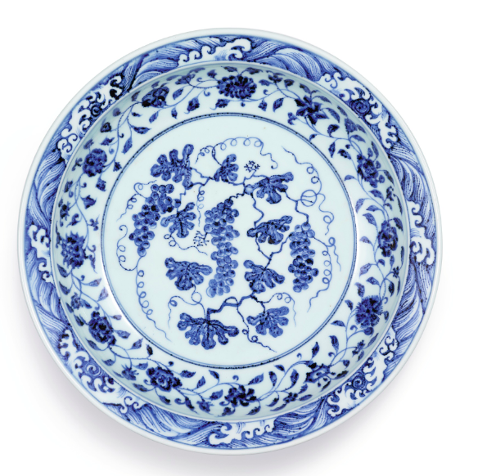
Conclusion
Positive correlation
Medium matters
Location matters
Month doesn’t matter

Slide 22
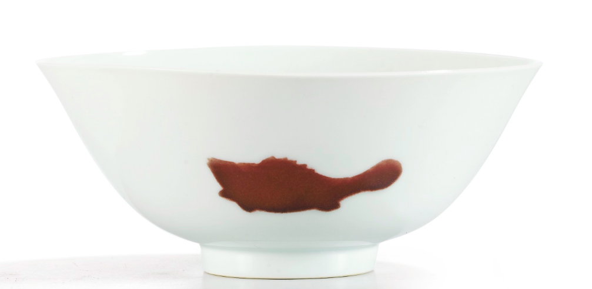
Limitations
Time frame limits conducting time-series analysis
Premium calculation may be distorted
Lack of #data due to difficulty of data collection

